Slide 1
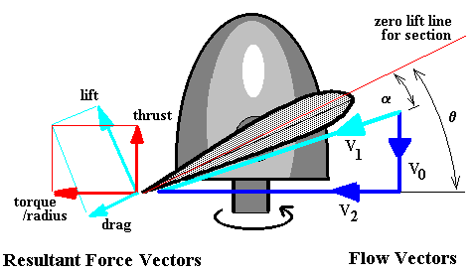
Q1 How does the propeller generate the thrust?
Direction of rotation of the propeller vs Thrust

Slide 2
Q1 How does the propeller generate the thrust?
Newton’s third law
Bernoulli's Law

Slide 3
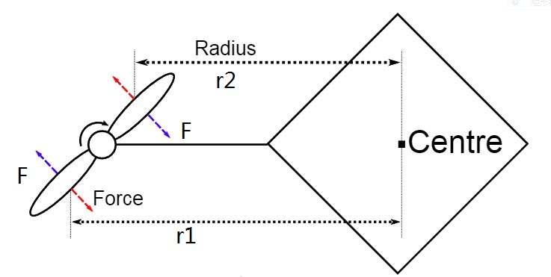
Q2 Why is specific arrangement on propellers needed?

Slide 4
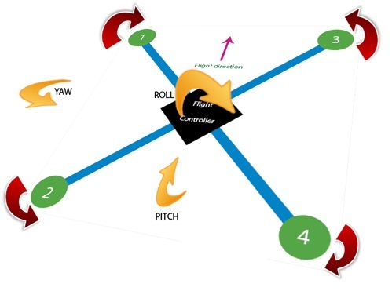
Q2 Why is specific arrangement on propellers needed?

Slide 5
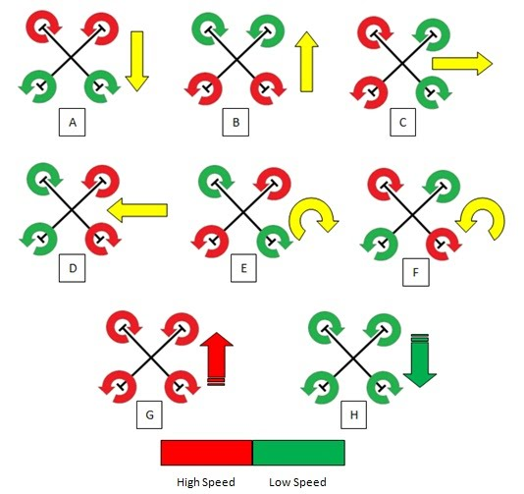
Q3 How does a quadcopter make motions?

Slide 6
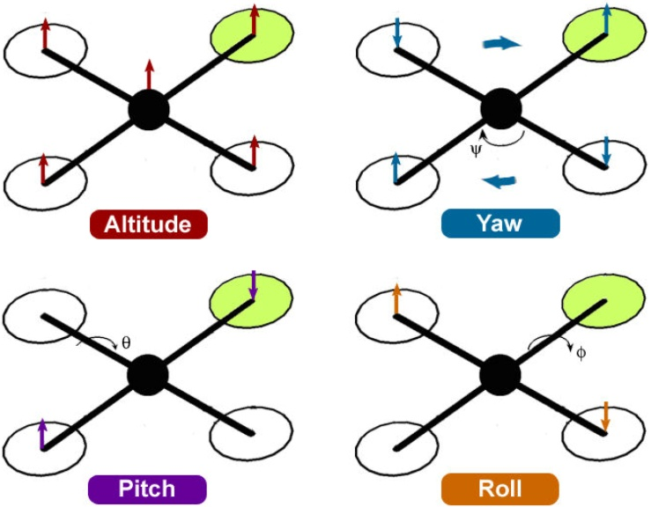

Slide 7
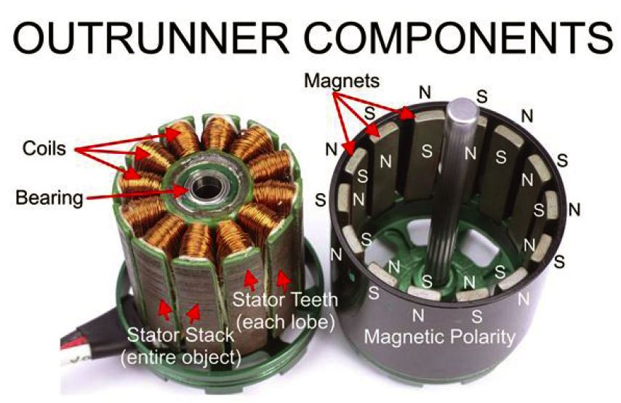
Q4 How does ECS work?

Slide 8
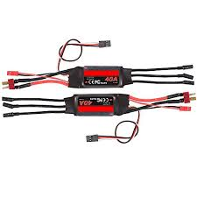
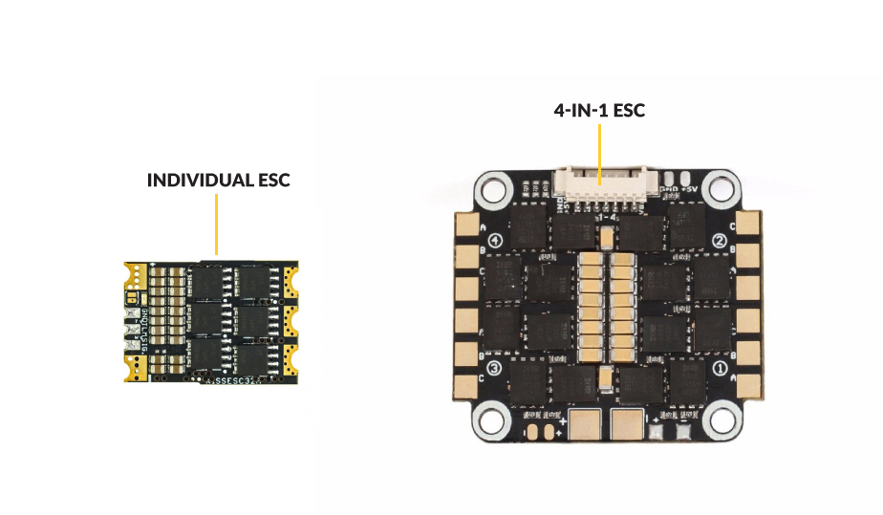
Q4 How does ECS work?
Electronic speed controller (ESC)
The job of the ESC is to switch on power to the motor coils at incredibly fast rates, and decide on how much current they can pass to the motors.

Slide 9
Quadcopter frame design
All possible considerations in quadcopter design. Discussion (weight, strength, ……)
Define the target. (Speed optimized, heavy lift Optimized, …….)
Refine the requirements for the target.
Thinking of the best structure and material.

Slide 10
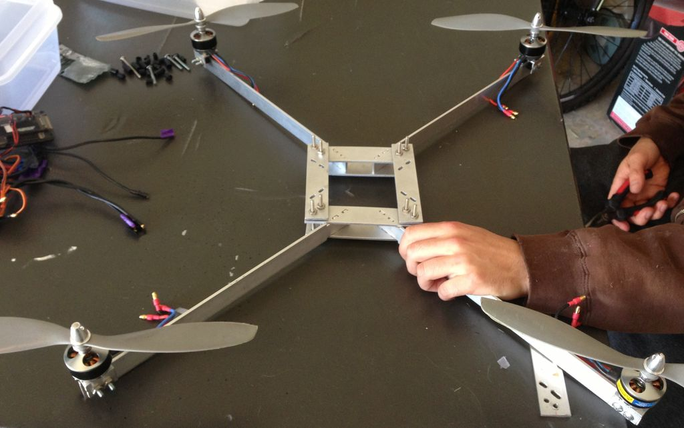
Quadcopter frame design

Slide 11
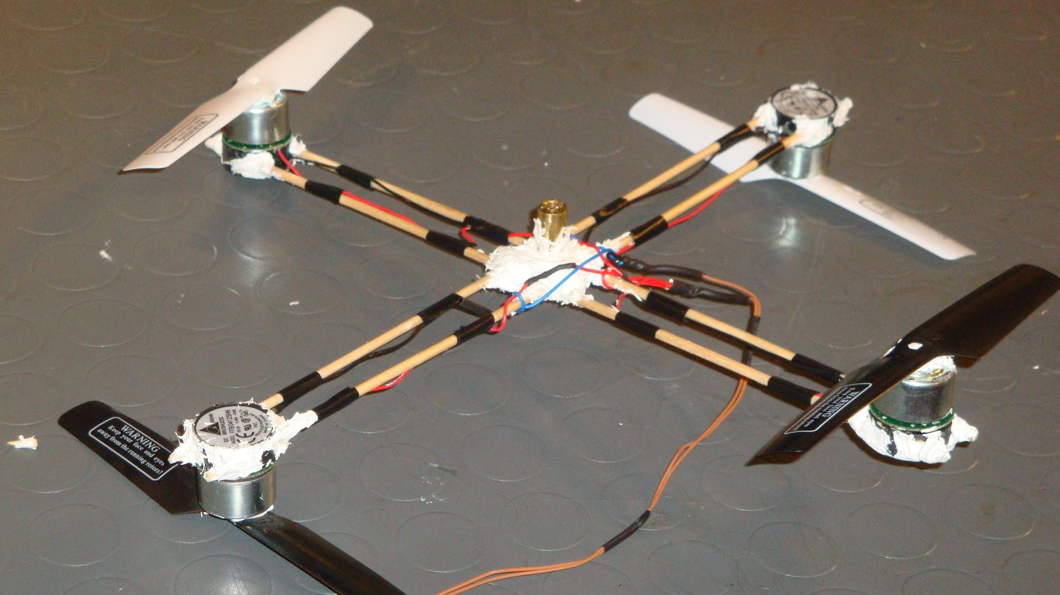
Quadcopter frame design

Slide 12
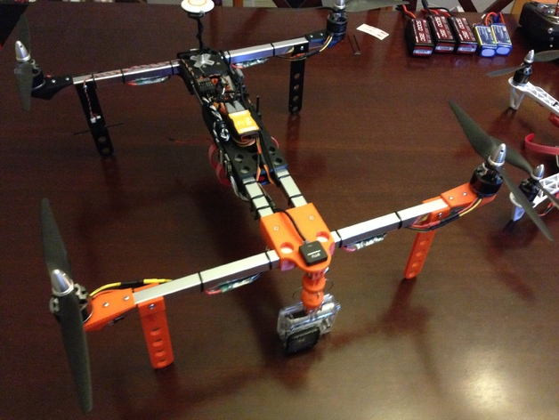
Quadcopter frame design

Slide 13
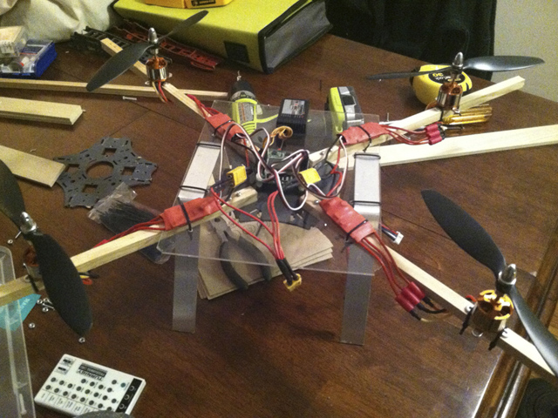
Quadcopter frame design

Slide 14
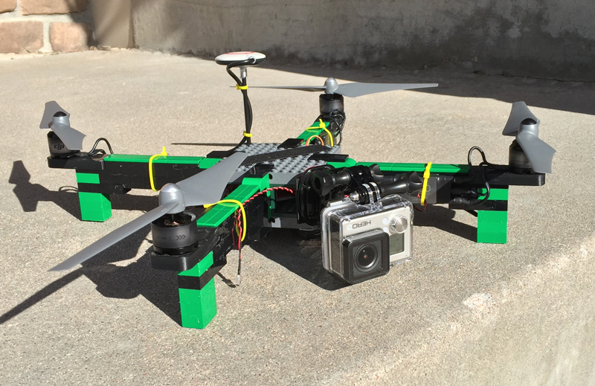
Quadcopter frame design

